Slide 1

Combining OR and Data Science – Refresher Tutorial
Till Porrmann
Decison Analytics Group Uni Bielefeld

Slide 2

Part 1: Getting started with Jupyter Notebooks
Till Porrmann
Decison Analytics Group Uni Bielefeld

Slide 3
What we will do today:
Introduction
Download and install Anaconda
Learn how to work with Jupyter Notebooks
Programming in Python (basics)
Peek View of:
NumPy
MatPlotLib
Cliffhanger

Slide 4
Introduction
Downloading Anaconda
Programming in Python
MatPlotLib
Introduction
How to work with Notebooks
NumPy
Cliffhanger
Let‘s go!
How exciting
Half way there
This is fun
Oh no, already over!

Slide 5
Introduction
This format:
Non-mandatory Tutorial
Make sure everything is set up right
Giving you room for questions
Getting the basics before starting with „advanced“ stuff
Kinda informal, probably a little messy at times
Interrupt me whenever you feel like it

Slide 6
Introduction
About me:
Till Porrmann (Mail: till.porrmann@uni-bielefeld.de)
Ph.D. student in the Decision Analytics group of Michael Römer
Highly motivated for teaching
Second time supporting this course
Office Hours every Monday 15:00-16:00

Slide 7
Introduction
Jupyter Notebooks:
Application for writing code
3 primary programming languages: Julia, Python and R
Combination of Code and Markdown
Based on IPython
What we will use it for:
(Interactive) coding
Graphical output
Writing optimization programs (with python-mip, gruobipy or similar)

Slide 8
Downloading Anaconda
Downloading Anaconda
Programming in Python
MatPlotLib
Introduction
How to work with Notebooks
NumPy
Cliffhanger
Let‘s go!
How exciting
Half way there
This is fun
Oh no, already over!

Slide 9
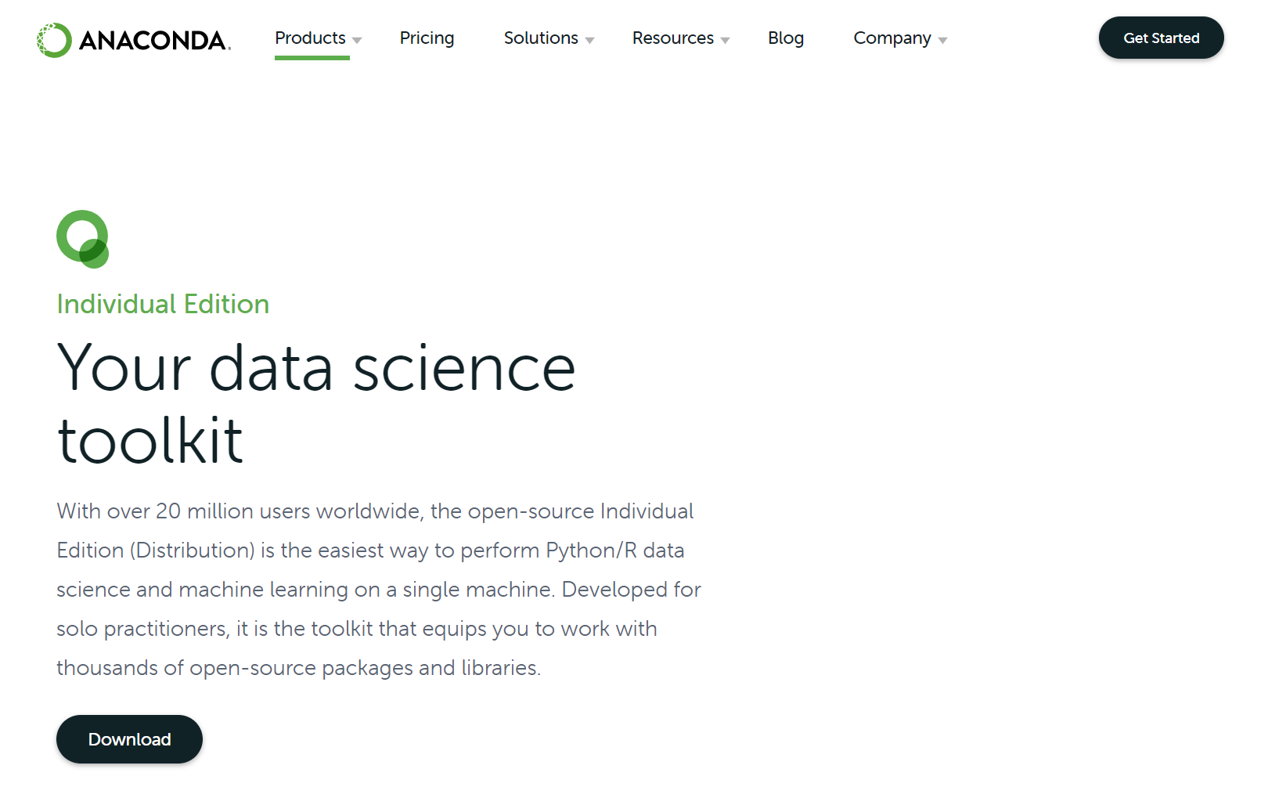
Downloading Anaconda
At https://www.anaconda.com/products/individual click Download
Select the installer for your operating system
Run the installation
(Start Anaconda Prompt, type:
conda info to see if the installation worked properly
Jupyter notebook to start)

Slide 10
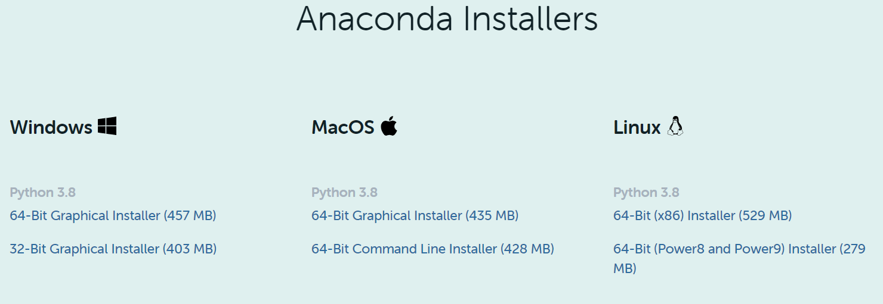
Downloading Anaconda
At https://www.anaconda.com/products/individual click Download
Select the installer for your operating system
Run the installation
(Start Anaconda Prompt, type:
conda info to see if the installation worked properly
Jupyter notebook to start)

Slide 11
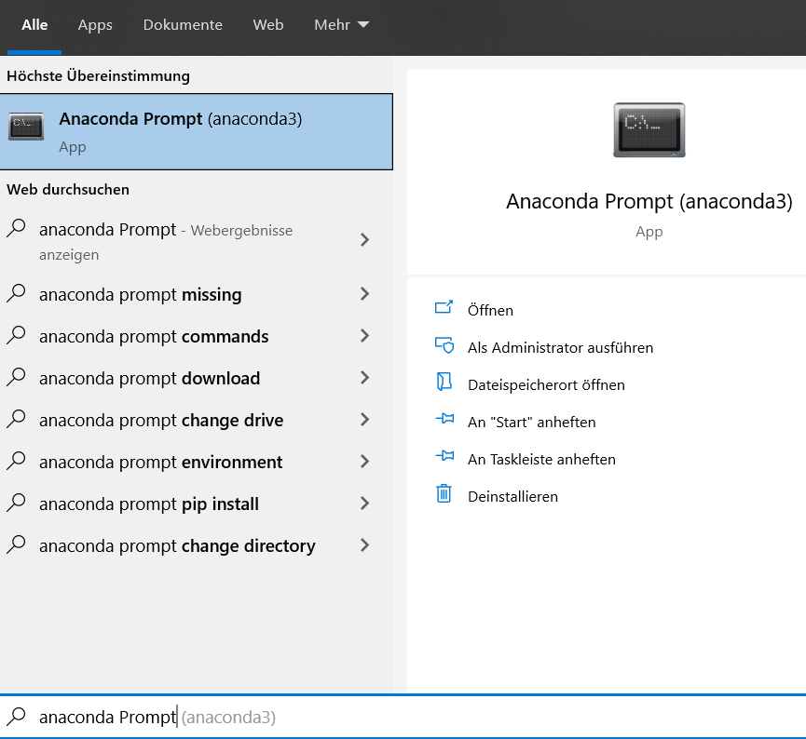
Downloading Anaconda
At https://www.anaconda.com/products/individual click Download
Select the installer for your operating system
Run the installation
(Start Anaconda Prompt, type:
conda info to see if the installation worked properly
Jupyter notebook to start)

Slide 12
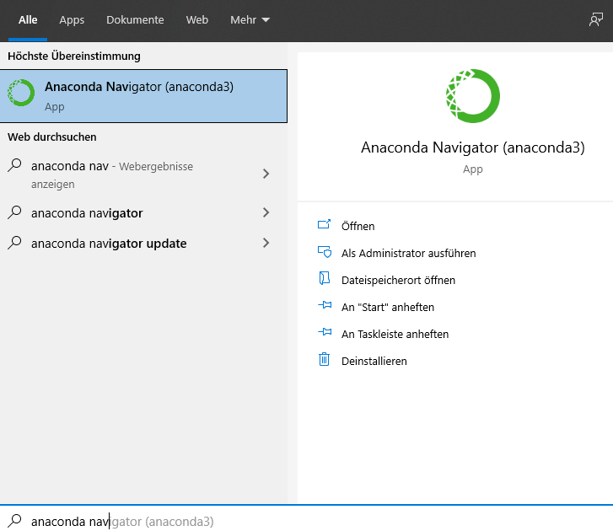
Downloading Anaconda
At https://www.anaconda.com/products/individual click Download
Select the installer for your operating system
Run the installation
Start Anaconda Navigator

Slide 13
How to work with Notebooks
Downloading Anaconda
Programming in Python
MatPlotLib
Introduction
How to work with Notebooks
NumPy
Cliffhanger
Let‘s go!
How exciting
Half way there
This is fun
Oh no, already over!

Slide 14
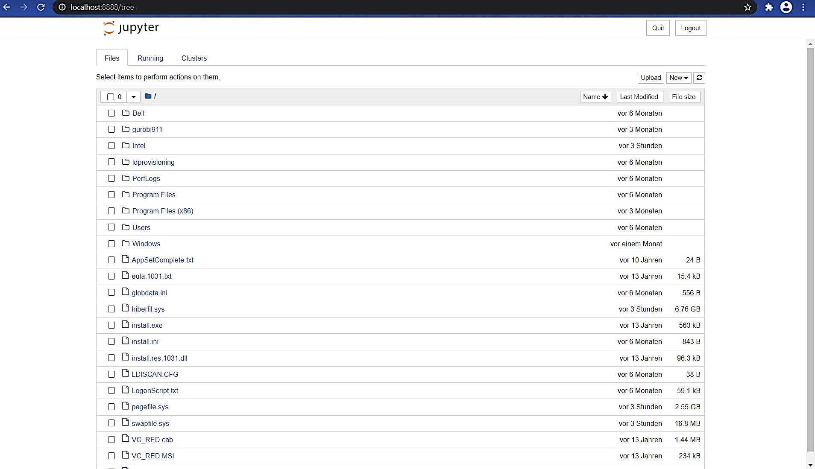
Create a Notebook
Running in your standard browser
Folder Overview, navigate through clicking
Create or delete folders/ files
General advice: keep your stuff together:
Make folders
Structure them
Learn to be a good namer
Maybe consider using a version control system like git

Slide 15
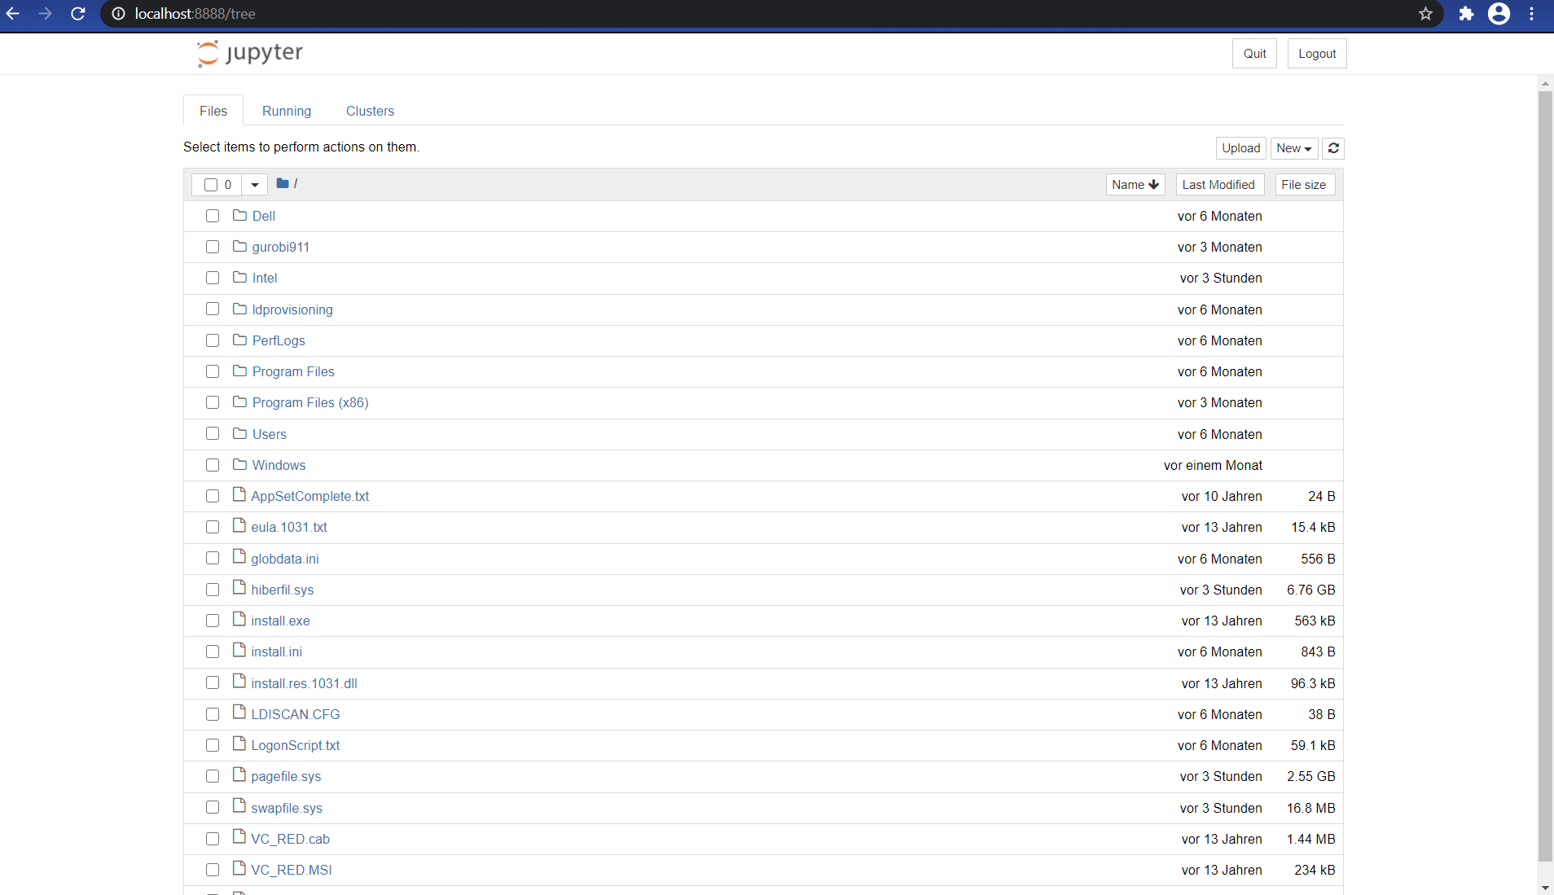
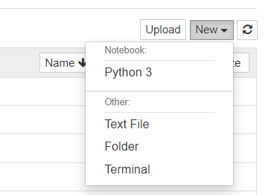
Create a Notebook
Running in your standard browser
Folder Overview, navigate through clicking
Create or delete folders/ files
General advice: keep your stuff together:
Make folders
Structure them
Learn to be a good namer
Maybe consider using a version control system like git
New → Python 3 to create a new Notebook

Slide 16
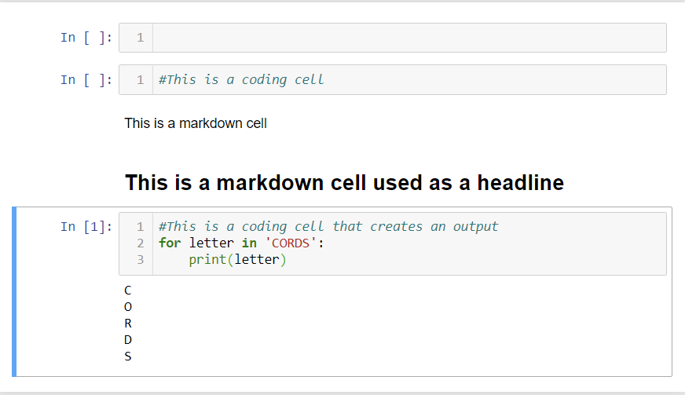
How to work with Notebooks
Working with cells
You can click on and in cells („Command“ and „Edit“-Mode)
Create cells with a (above current cell) or b (below current cell) while in Command-Mode
Two important types of cells:
Markdown (Hotkey m): For writing natural language
Code (Hotkey y): For writing (python) code

Slide 17
How to work with Notebooks
Markdown cells:
Used for documentation and structure
Allow formating in different ways, for example simple emphasis, lists, links or LaTeX code
Short overview of basic markdown functions at https://ingeh.medium.com/markdown-for-jupyter-notebooks-cheatsheet-386c05aeebed

Slide 18
How to work with Notebooks
Code cells:
Used for writing and testing actual code
Cells have an input and an output
# allows commenting within a code cell
Details on basic coding will come up later
You can run cells:
Pressing Ctrl+Enter runs a cell
Markdown features or code will be executed

Slide 19
How to work with Notebooks
While you work with the notebook, all variables will be saved
This can be super cool and really bad
You can test different configurations quite easily
If you don‘t know which state you‘re in, you‘re gonna have a bad time
If you want to run code directly in the terminal, you can use ! at the beginning of a line of code

Slide 20
Programming in Python (basics)
Downloading Anaconda
Programming in Python
MatPlotLib
Introduction
How to work with Notebooks
NumPy
Cliffhanger
Let‘s go!
How exciting
Half way there
This is fun
Oh no, already over!

Slide 21
Programming in Python
Printing (‘Hello, World!‘)
Variables
No static types in python
Assigning with =
Basic types are int, float, string, …
Operators
Lists
Conditions (if)
Loops (for, while)

Slide 22
Programming in Python
Functions
def function_name(arguments):
Packages
from .. import .. as ..
Some need to be installed first (installing with !pip install ..)
There is MUCH more:
https://www.learnpython.org/en/
https://www.datacamp.com/courses/intro-to-python-for-data-science

Slide 23
NumPy
Downloading Anaconda
Programming in Python
MatPlotLib
Introduction
How to work with Notebooks
NumPy
Cliffhanger
Let‘s go!
How exciting
Half way there
This is fun
Oh no, already over!

Slide 24
NumPy
(Installing: !pip install numpy)
Importing the package: import numpy as np
We will look at NumPy arrays
Kinda like lists, but faster and more flexible in many cases
Create an array:
array_name = np.array(..)
array_name = np.arange(..)
…
Access elements: array_name[element number]
More on NumPy in the next weeks

Slide 25
MatPlotLib
Downloading Anaconda
Programming in Python
MatPlotLib
Introduction
How to work with Notebooks
NumPy
Cliffhanger
Let‘s go!
How exciting
Half way there
This is fun
Oh no, already over!

Slide 26
MatPlotLib
(Installing: !pip install matplotlib)
Importing the package: from matplotlib import pyplot as plt
Used to show graphs of all kinds
plt.plot( .. , .. ) for a simple plot
plt.title(‘ title of the plot ‘), plt.xlabel(‘ label of x axis ‘)
You can make subplots to show multiple graphs at once
More on MatPlotLib in the next weeks

Slide 27
Cliffhanger
Downloading Anaconda
Programming in Python
MatPlotLib
Introduction
How to work with Notebooks
NumPy
Cliffhanger
Let‘s go!
How exciting
Half way there
This is fun
Oh no, already over!

Slide 28
Cliffhanger
Next Refresher Tutorial:
Probably in May
(Mixed Integer) Linear Programming in Python (my personal favorite)
Things you could look at:
Cool graphs in MatPlotLib (with labels, colors and stuff)
Ways to work with NumPy (everybody loves arrays)
SciPy stats for distributions (for feeling like a fancy DataScientist)

Slide 29
Thank you, see you next time
Downloading Anaconda
Programming in Python
MatPlotLib
Introduction
How to work with Notebooks
NumPy
Cliffhanger
Let‘s go!
How exciting
Half way there
This is fun
Oh no, already over!

